Slide 1
Gomezgani Walumbe
MRA Tax Payer App Challenge

Slide 2
About the project
For this challenge I used the Model-View-Controller (MVC). The MVC is a well known implementation for a lot of systems. It is used by most industry used frameworks like laravel. MVC is an architectural pattern that separates an application into three main logical components: the model, the view, and the controller.

Slide 3
Development path
Mvc
Route protection
Validation
SPA

Slide 4
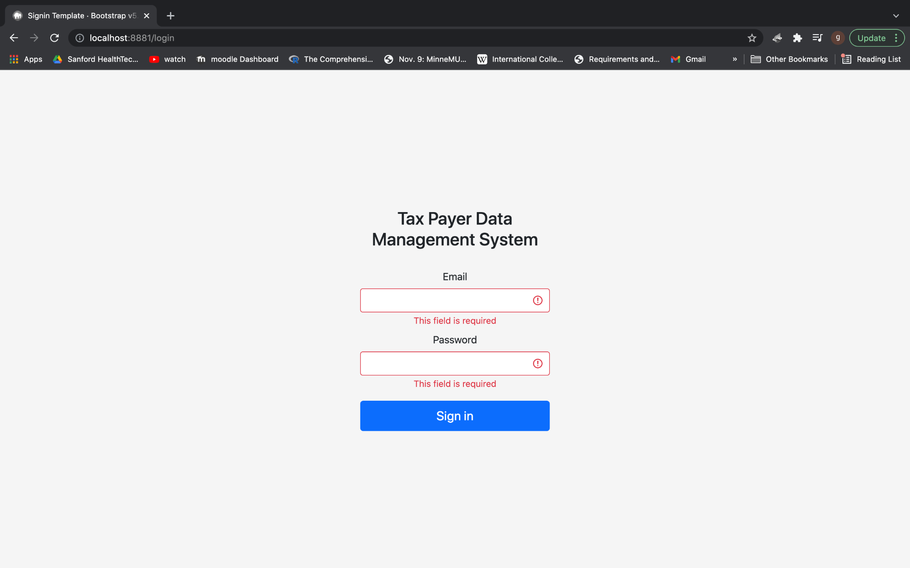
Login Page

Slide 5
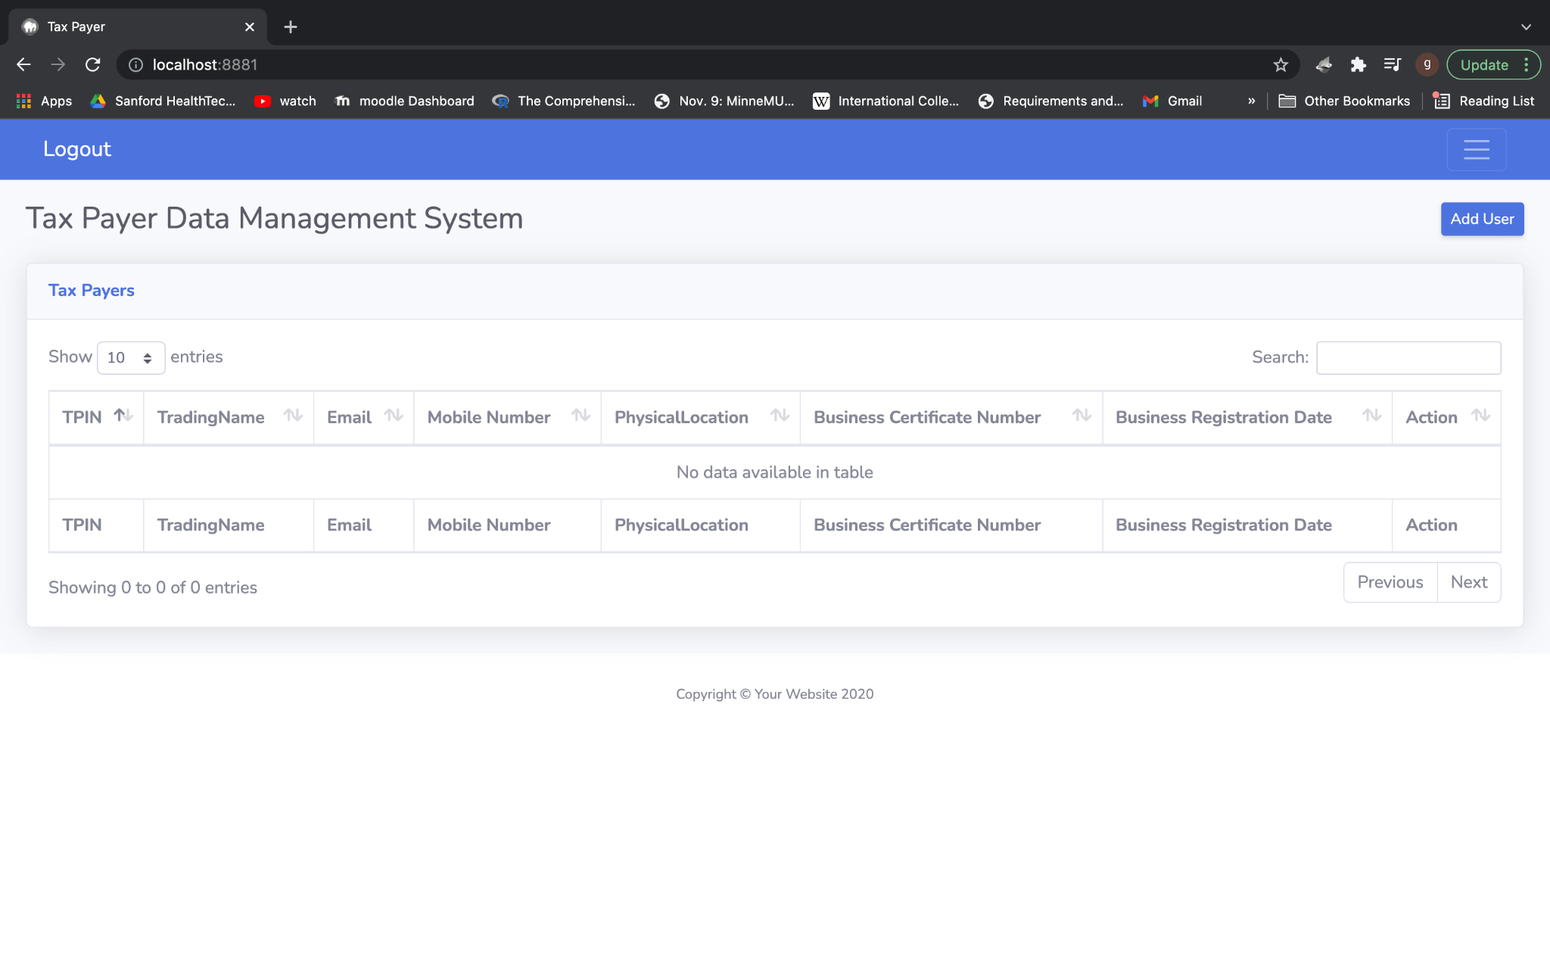
Home

Slide 6
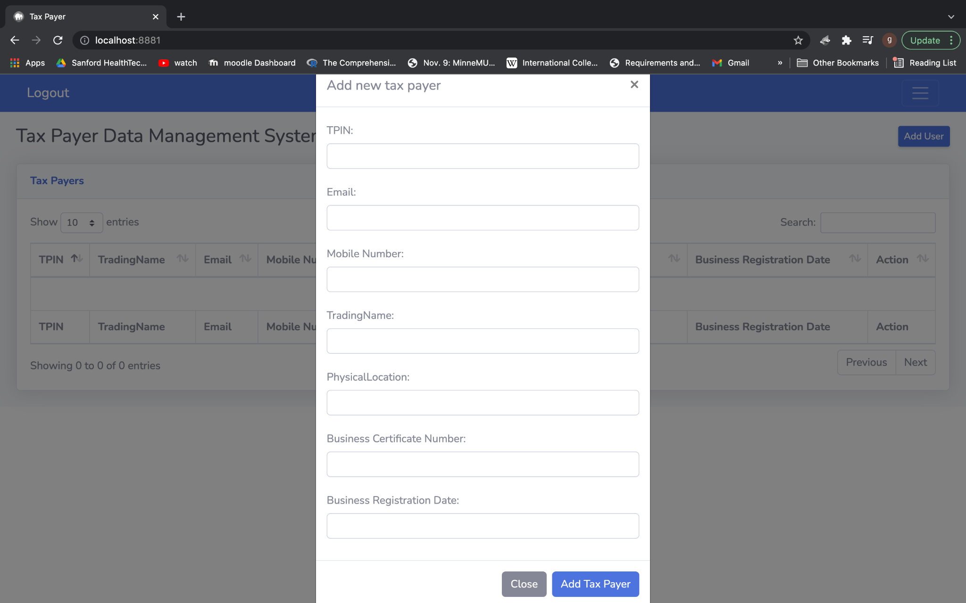
Add Tax Payer

Slide 7
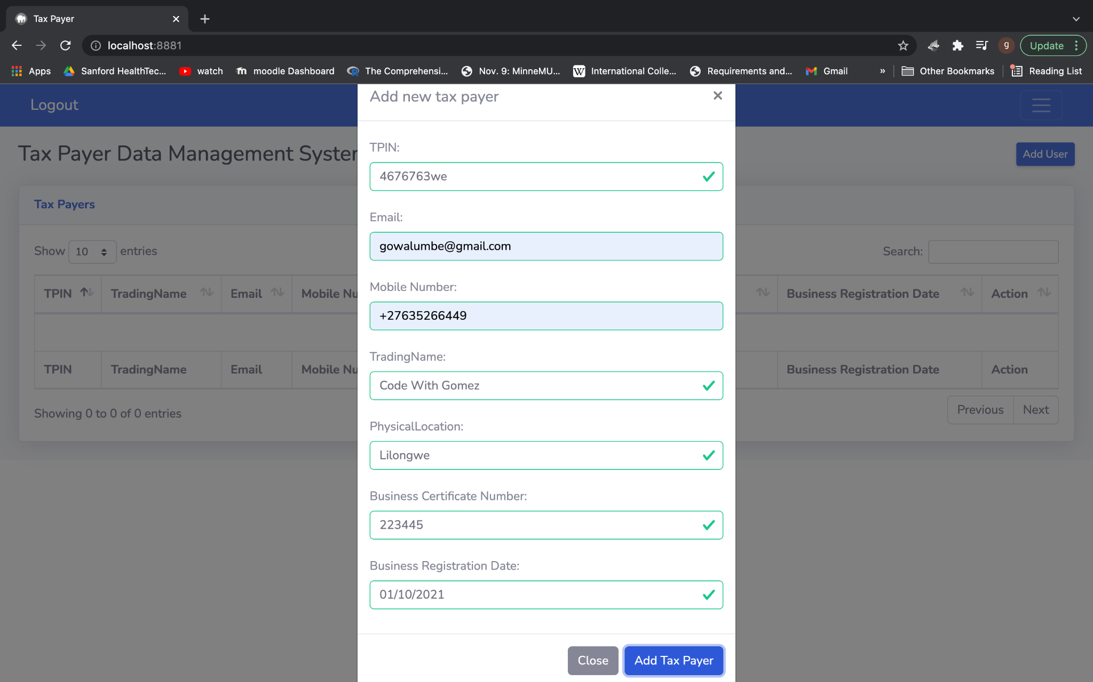
Validation

Slide 8
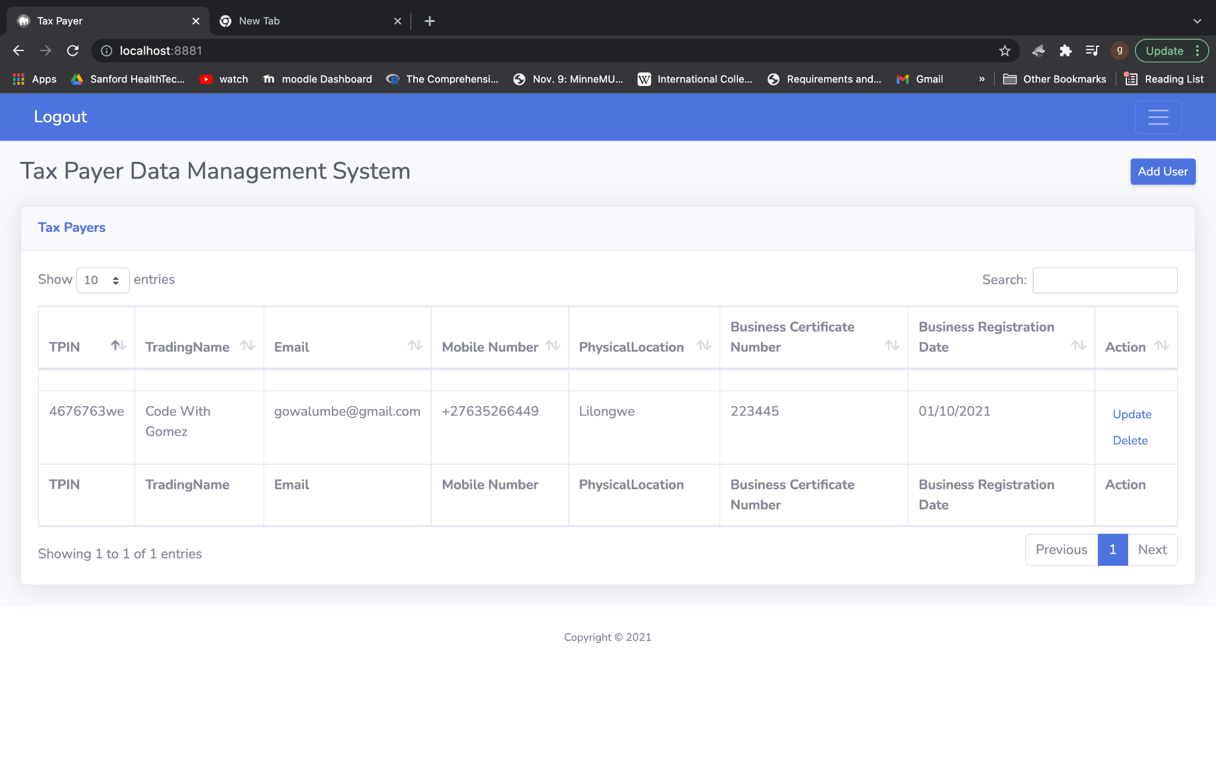
Dashboard with Data

Slide 9
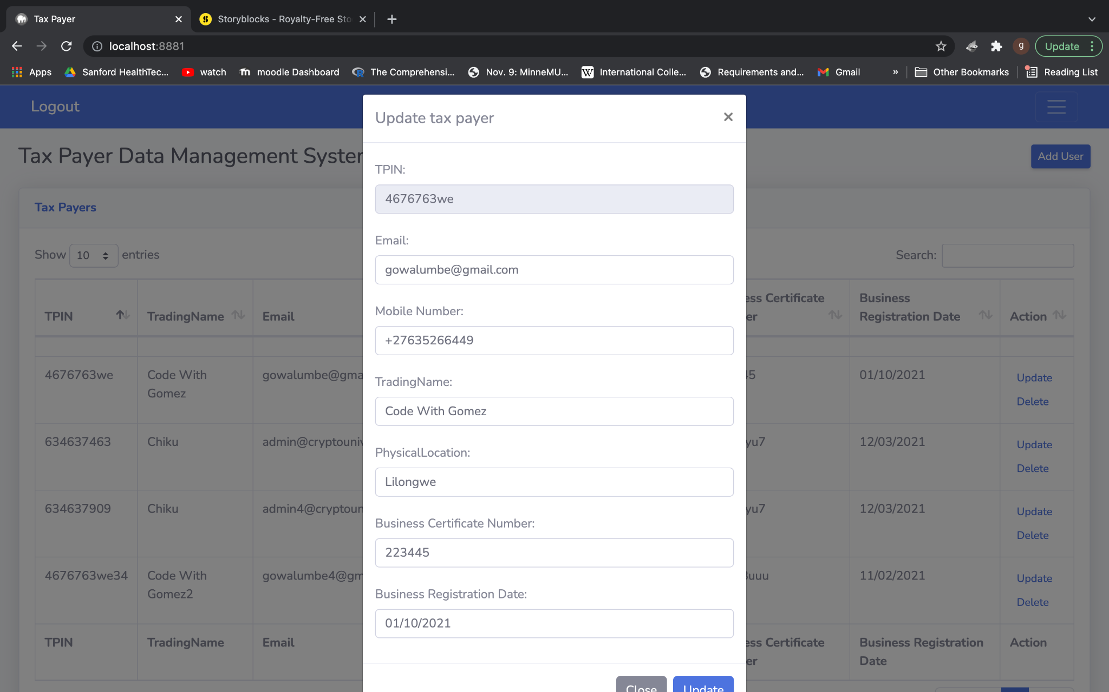
Update

Slide 10
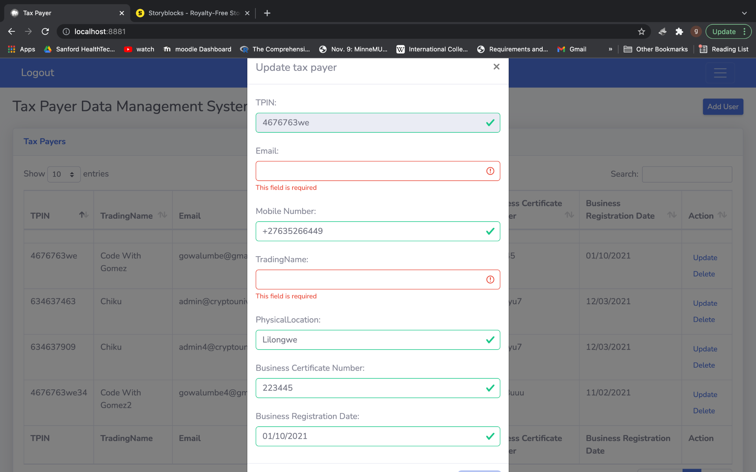
Validation on update

Slide 11
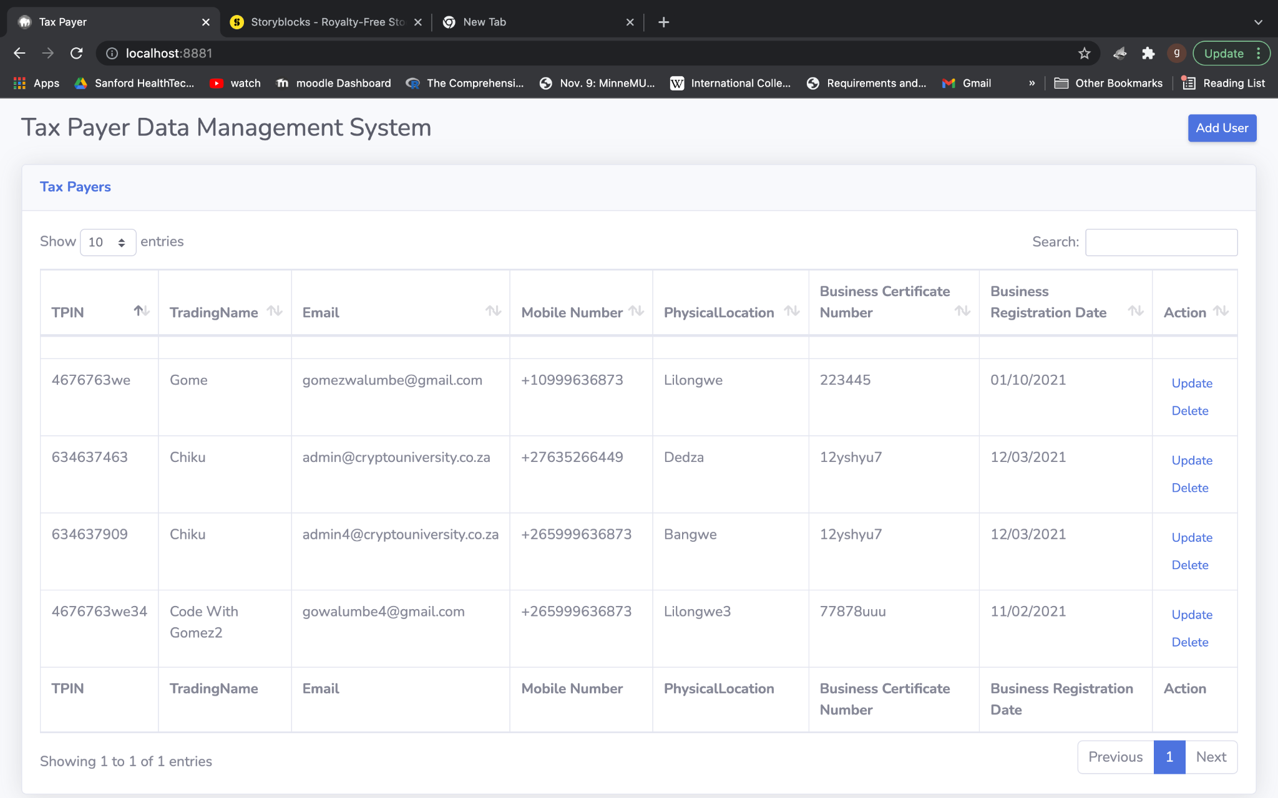
Dashboard
a

Slide 12

Delete

Slide 13
Thank you
Gomezgani Walumbe

